Slide 1

Gacek Design Group
Architectural Interiors

Slide 2
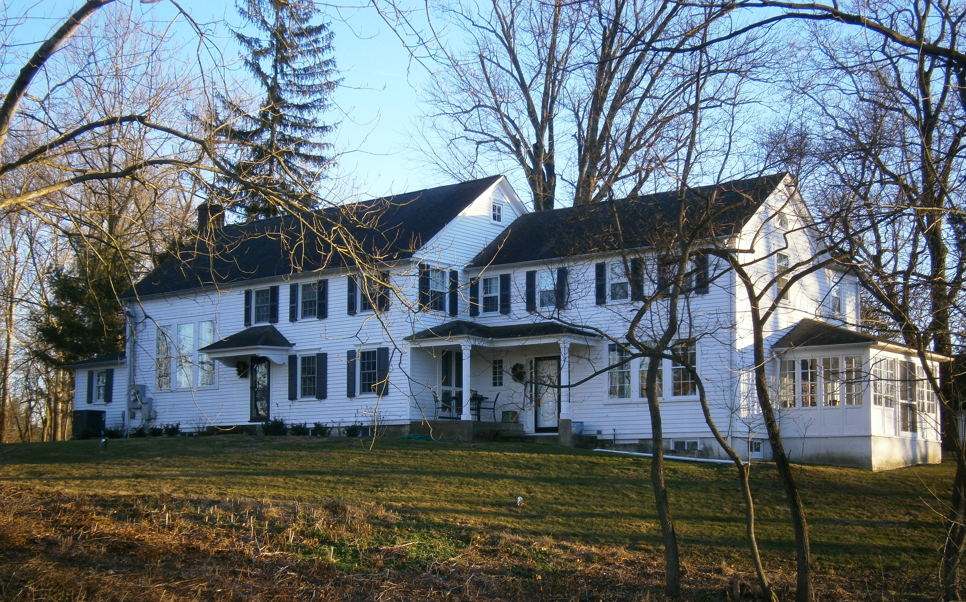
About Us
Full service, interior design & architectural consulting firm
  3,500 s/f design studio
  Central locale
Established and Experienced
  Established in 2005
  70 years experience in sales & marketing
  64 years experience in architecture, interior design industry
  54 years experience in production
  51 years experience in merchandising
  43 years experience in finance industry
  10 years experience in research
  9 years experience in homebuilding industry

Slide 3











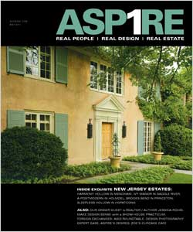



About Us
  Performance Driven
  2015 Honorable Mention Award
  Show House Interior Design
  Top 50 most popular pins in 2014

Slide 4
About Us
Diverse Portfolio
  Private clients, Commercial clients, New home builders, Developers
  model homes, sales centers, clubhouses, country clubs, luxury apartments
  offices, restaurants, retail, amenity spaces, lobbies, common areas

Slide 5










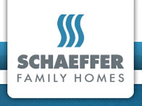











Commercial Clients

Slide 6
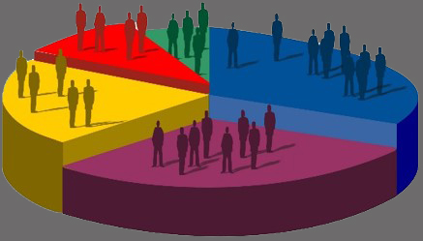










Our Value Proposition
  Conduct Market Research
    Demographic, geographic, psychographic data
    Generational
    Design, hospitality, builder trends
    Affluent buying behavior, preferences
    Client experiences

Slide 7

Our Value Proposition
  Understand the Competition
    Team collaboration
    Interview partners
    Shop the competition
    Gather data

Slide 8
Our Value Proposition
  Offer Experiential Merchandising
    Create a welcoming environment based on research
    Offer function and adaptability
    Provide an experience, tell a story
  Project: Office for an Advertising Agency
    Millennial Start up Company
      Process is Flexible – agile development and design based on needs
      Office space with no silos – work together at the same time in the same room
      Design to be thoughtful with powerful technology
    Office Design Elements
      Cool, colored lighting
      Adaptable, movable furniture, lots of rolling ottomans
      Fun Zone – ping pong table as conference table
      Graffiti art logo wall
      Company branded coffee house / lounge (Central Perk) with sharing table
      Seating with plug in headphones

Slide 9
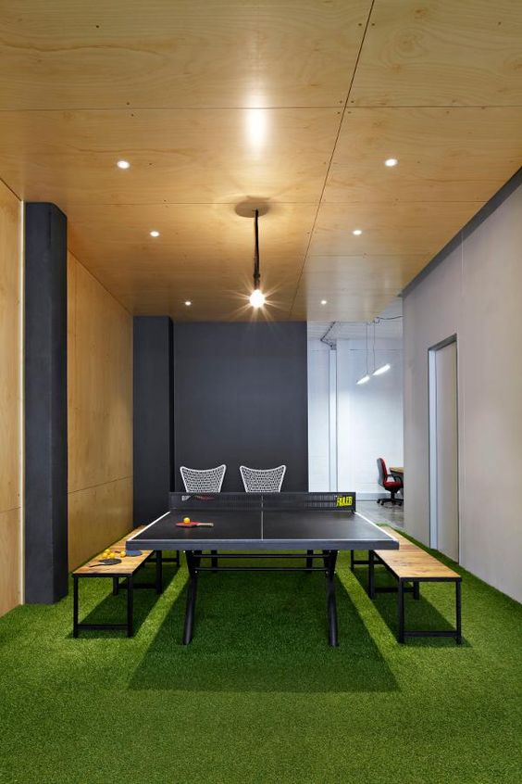
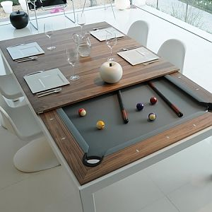
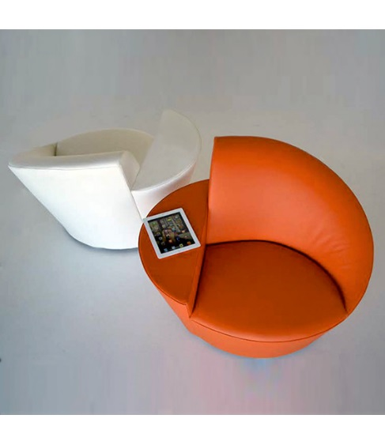
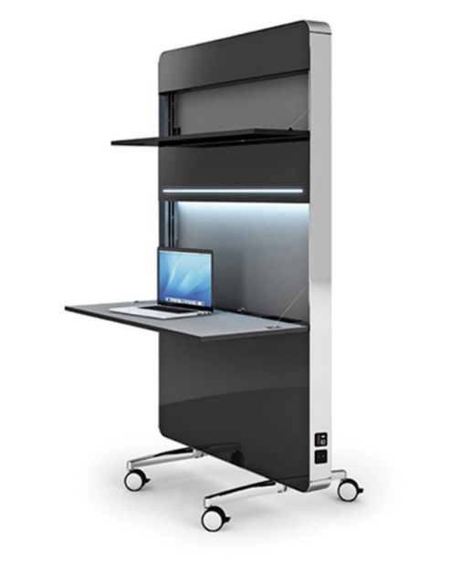
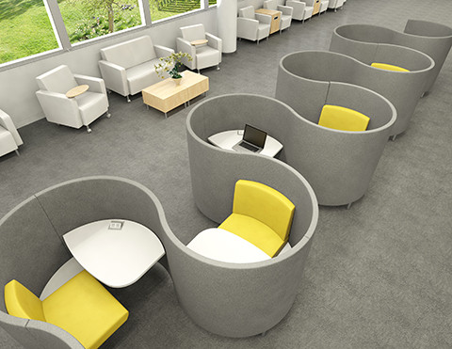
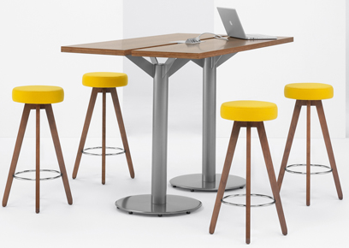
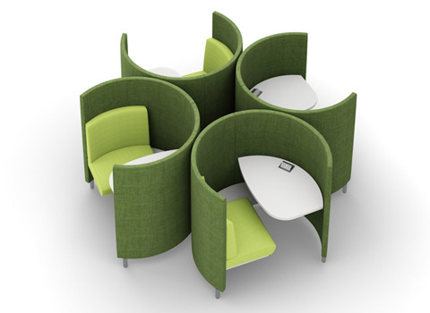
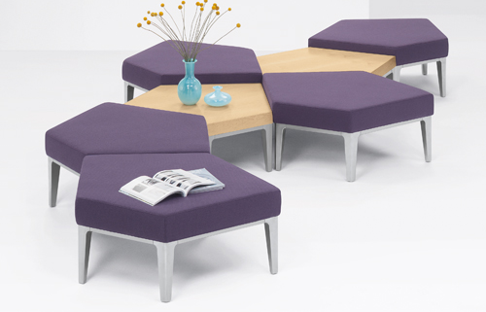
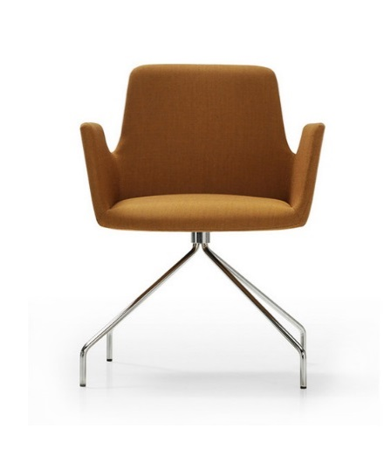
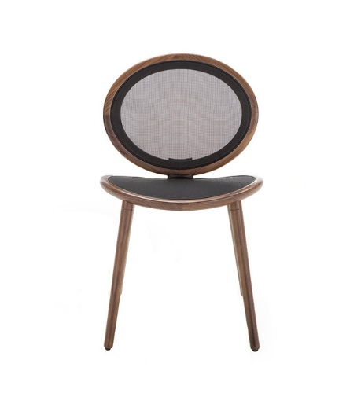
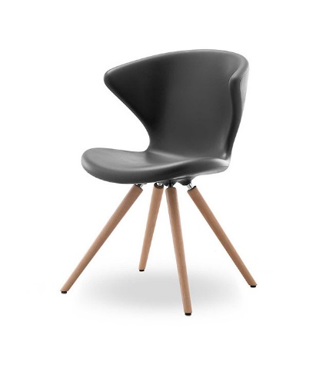
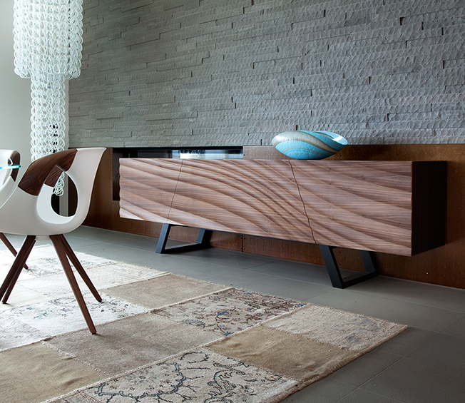
Our Value Proposition
  Offer Experiential Merchandising
    Office - Adaptable Inspiration Elements

Slide 10
What You Can Expect
    Successful design evokes an emotional response. The creative process is where we illustrate the Gacek Design Group signature style - a blend of natural elements with timeless, classic design.
    DESIGN PRESENTATION
      Presentation format to include project research findings
    DESIGN NARRATIVE
      Documented story that walks you through the space layout
    DESIGN PLAN – includes the following:
      Draw a space plan and furniture plan
      Create Inspirational Design Boards
      Draw elevations (including millwork) to illustrate memorable focal points
      Complete a detailed FINISH SCHEDULE with paint, wall covering, and specialty finishes
      Select materials and create a job specification document
      Present a design board illustrating color palette, furnishings, fabrics, art, lighting, rugs, and accessories
      Select and collaborate with custom fabricators for window treatments, and soft goods

Slide 11
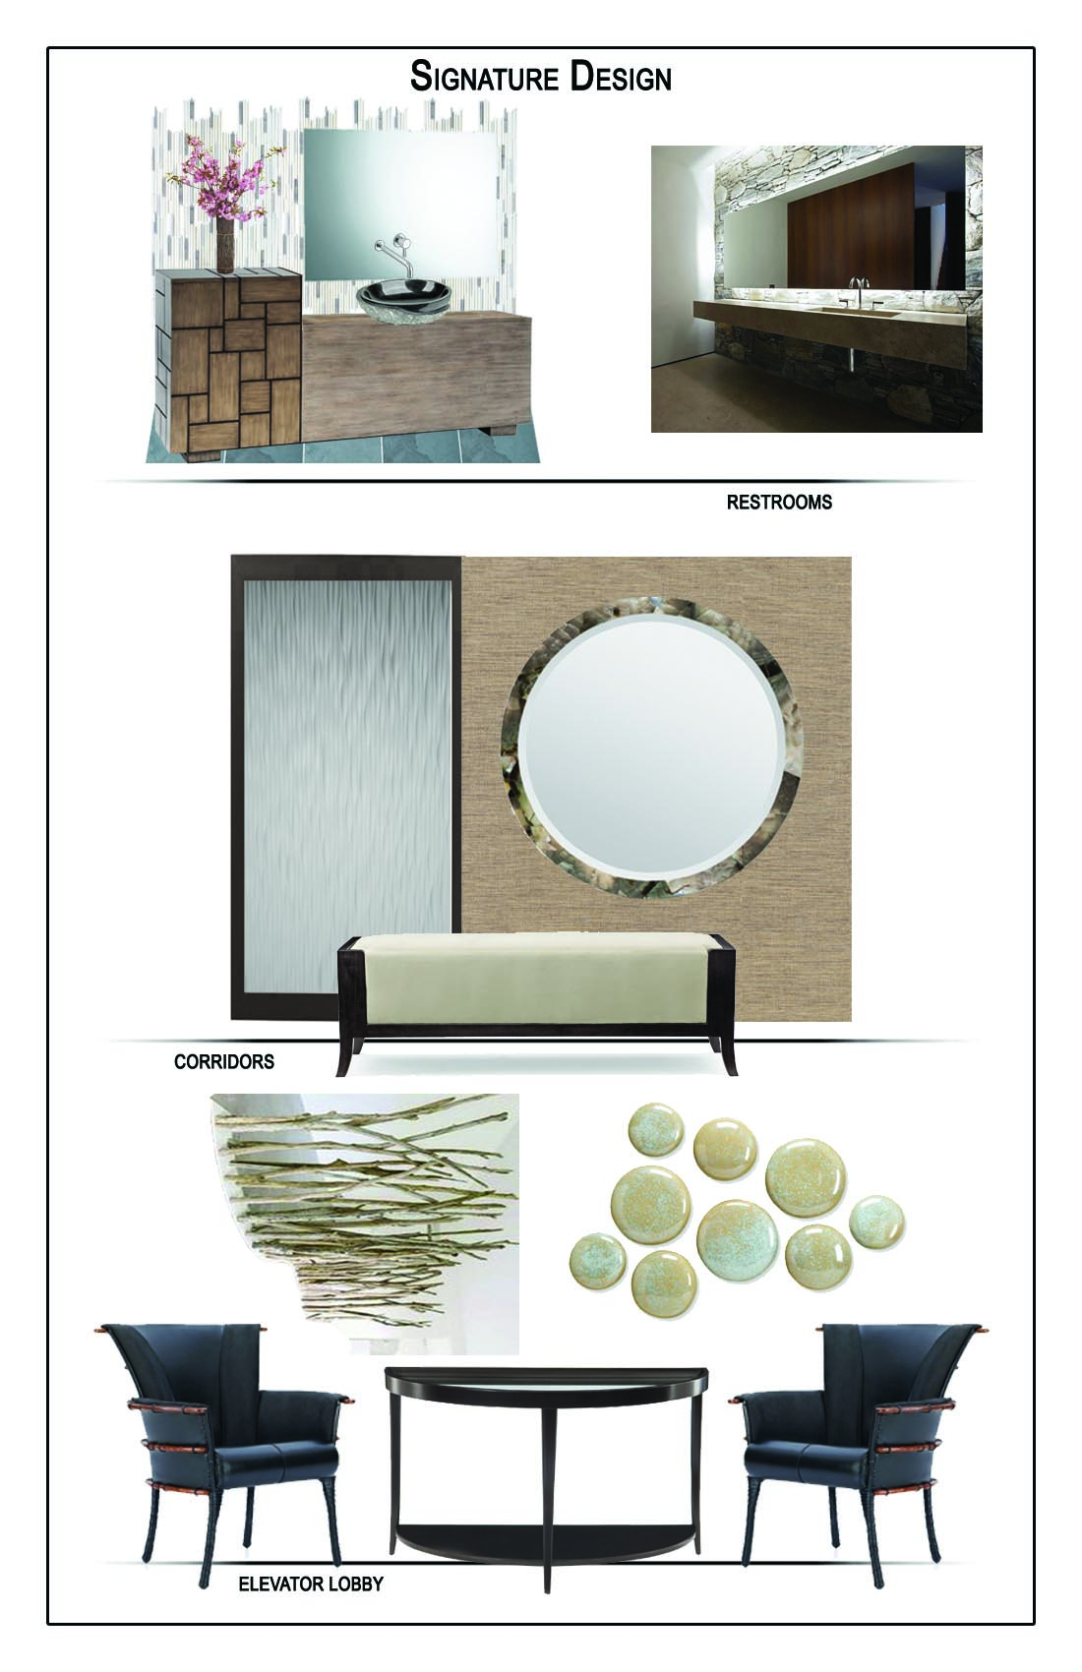
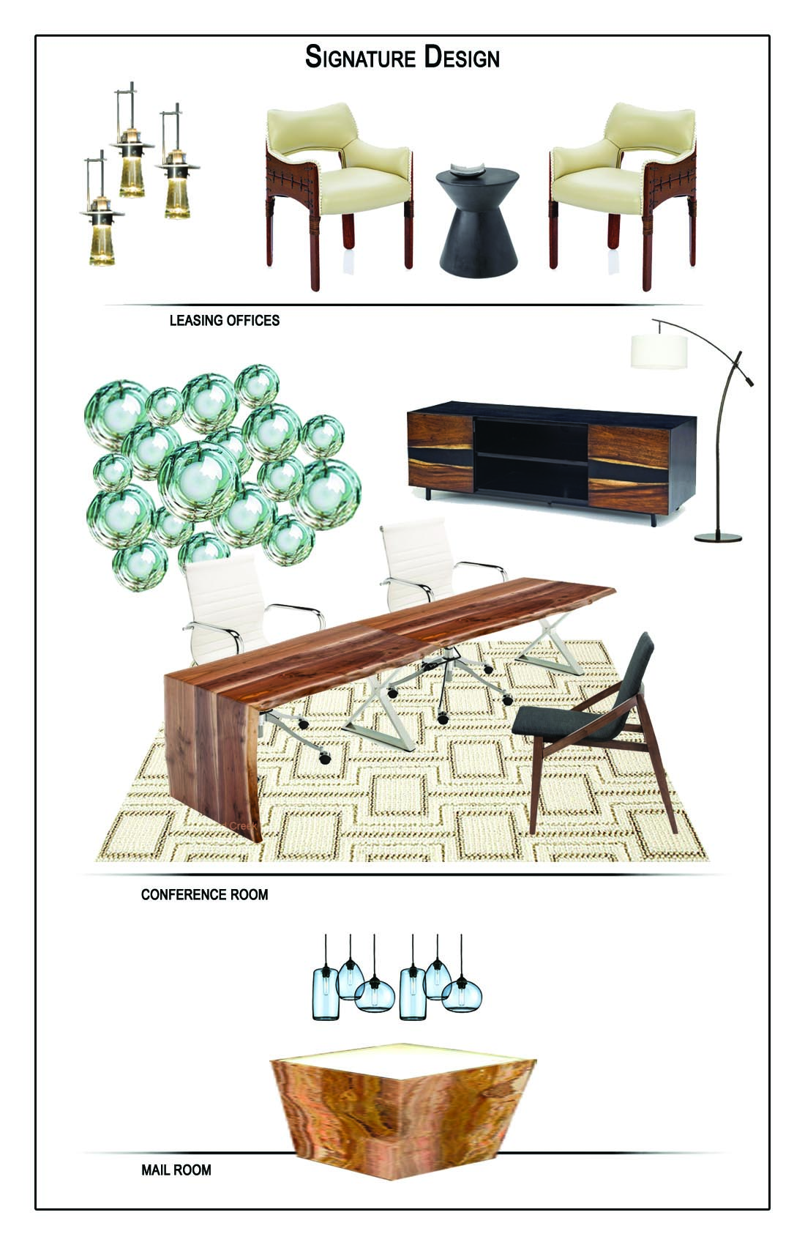
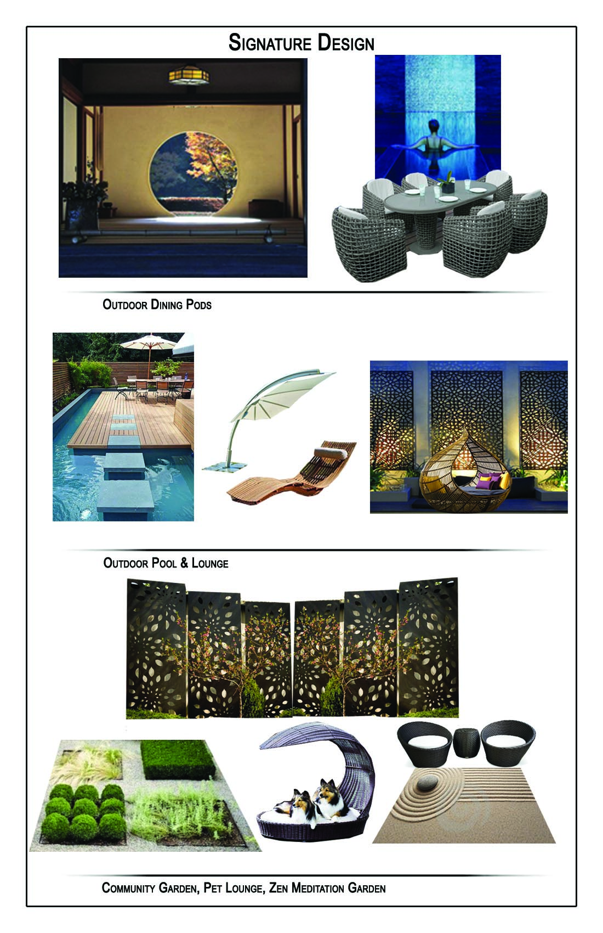
Design Plan
    Design Boards - Amenity Spaces - Modern Asian Design Style

Slide 12
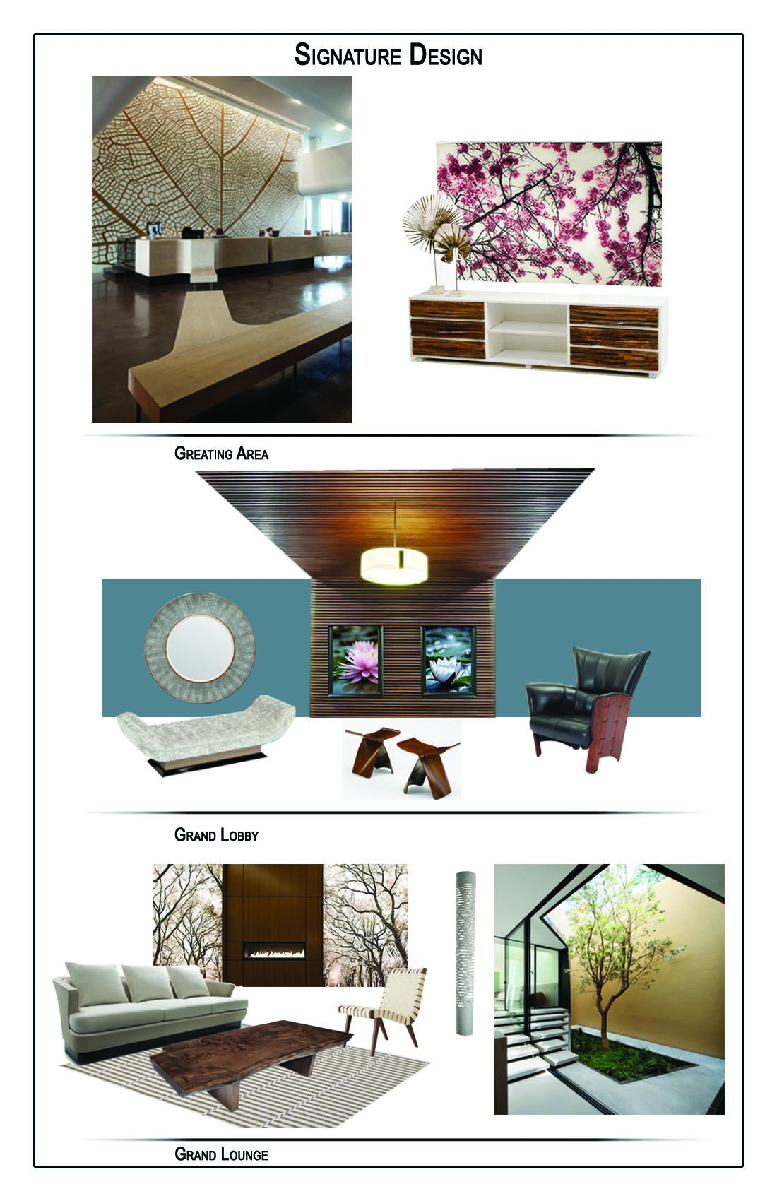
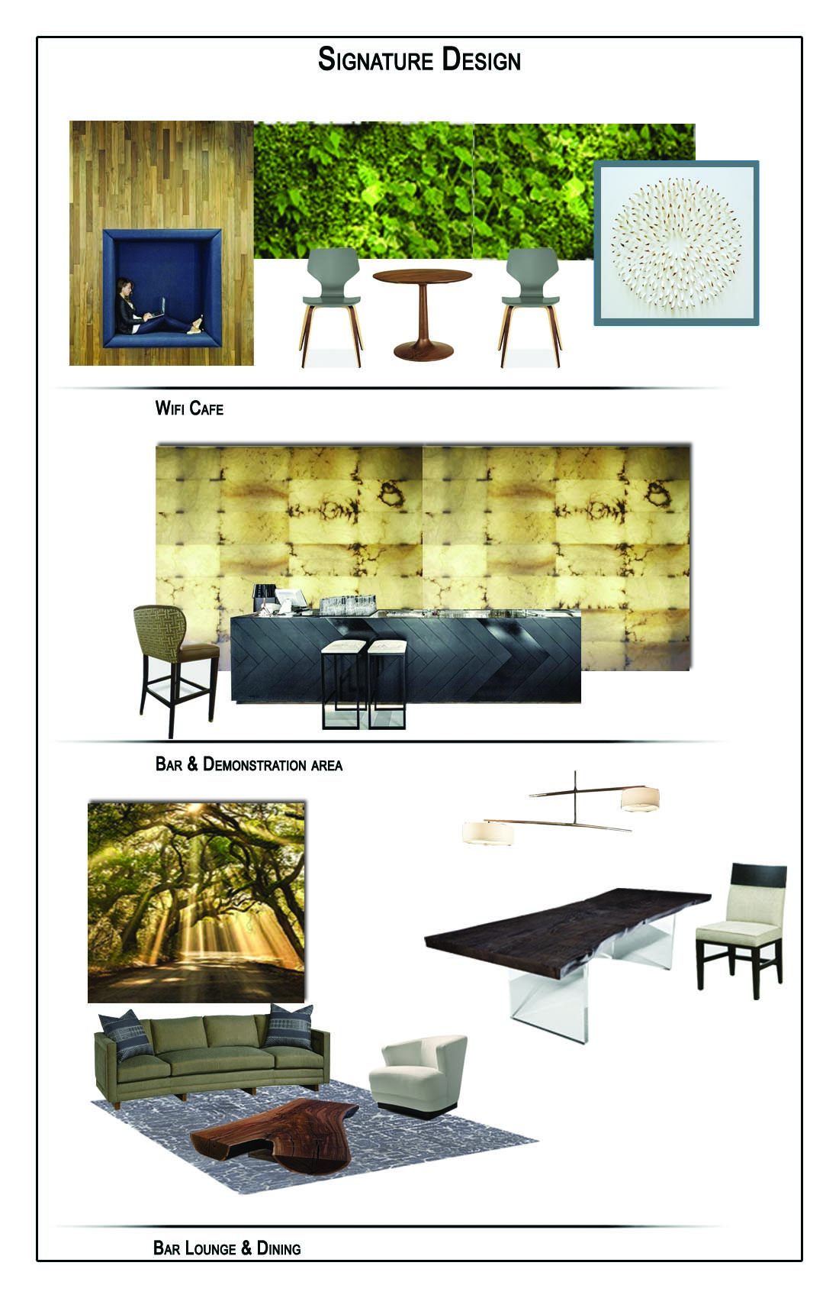
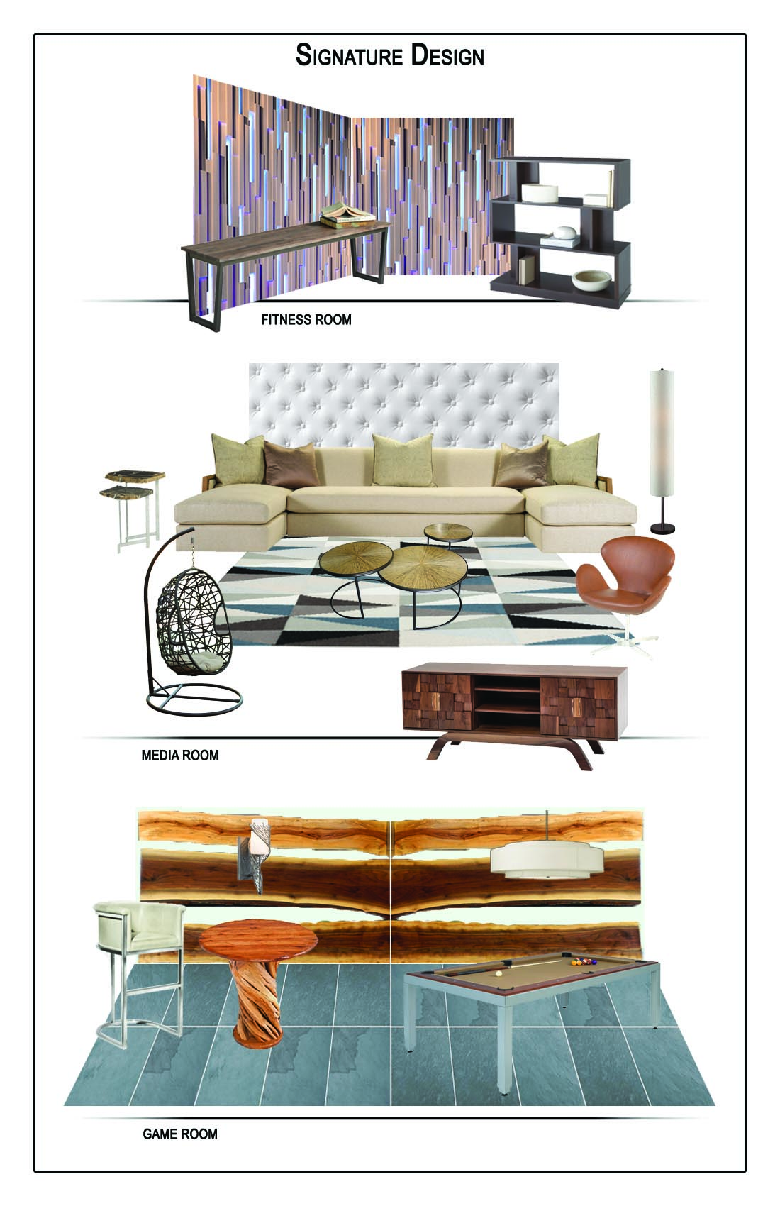
Design Plan
    Design Boards - Amenity Spaces - Modern Asian Design Style

Slide 13
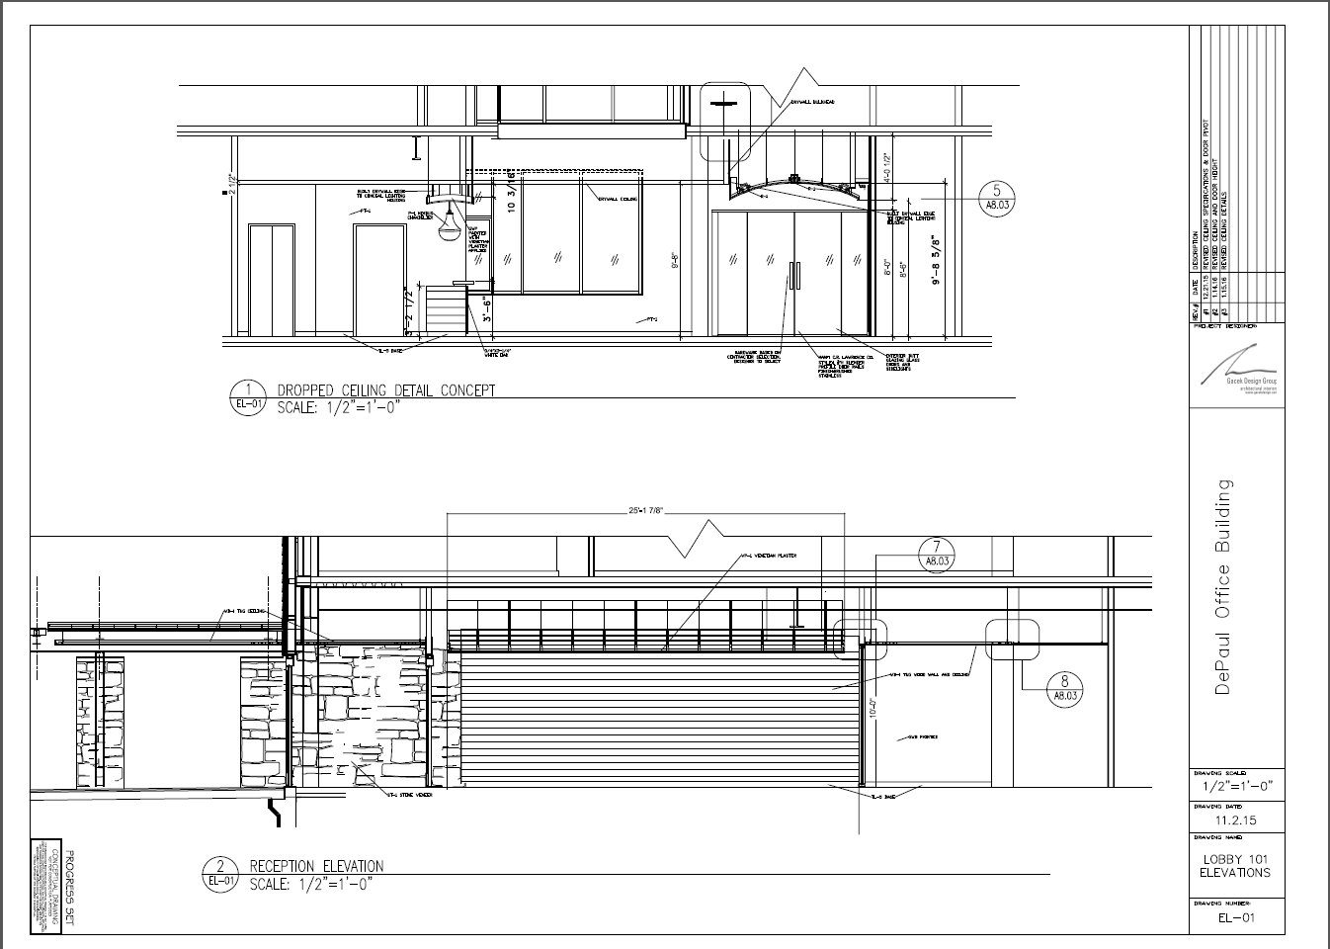
Design Plan
      Elevations to illustrate memorable focal points – office space lobby detail

Slide 14
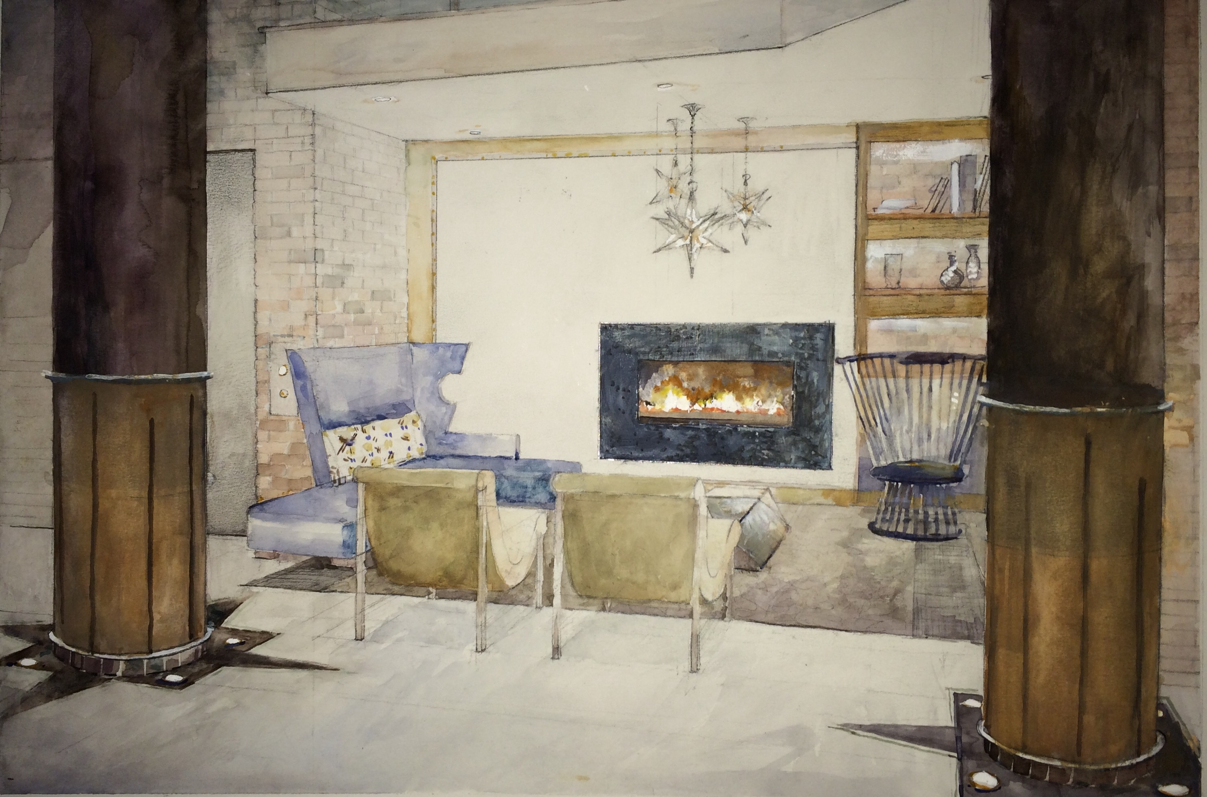
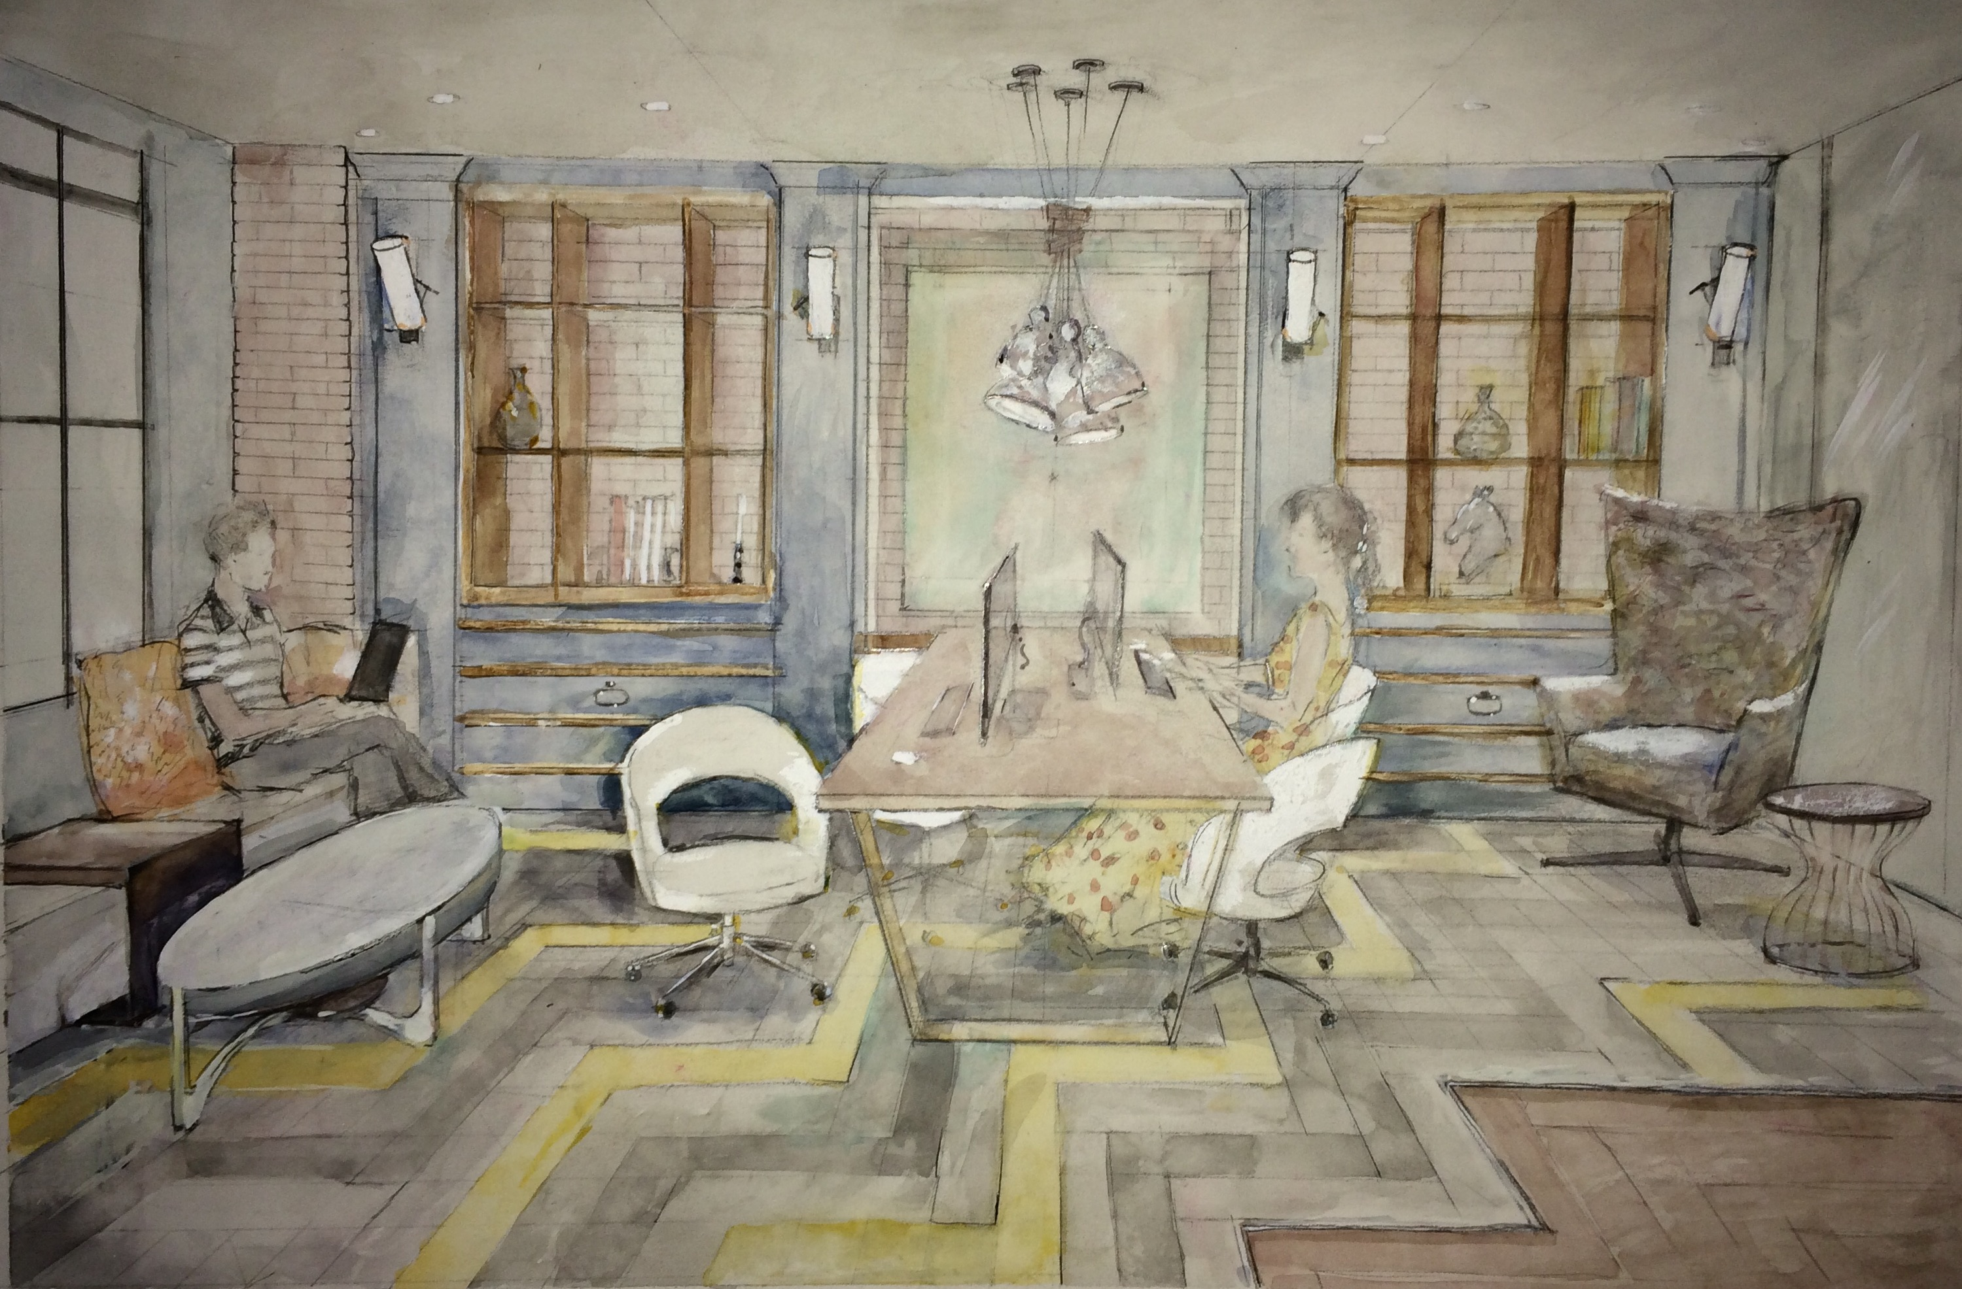
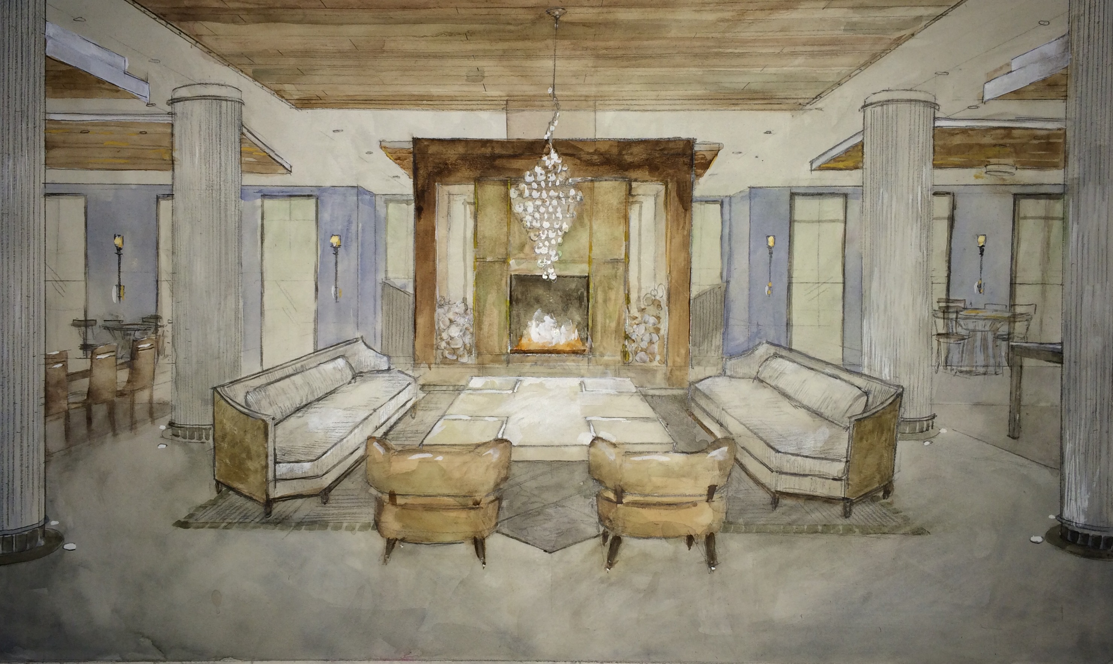
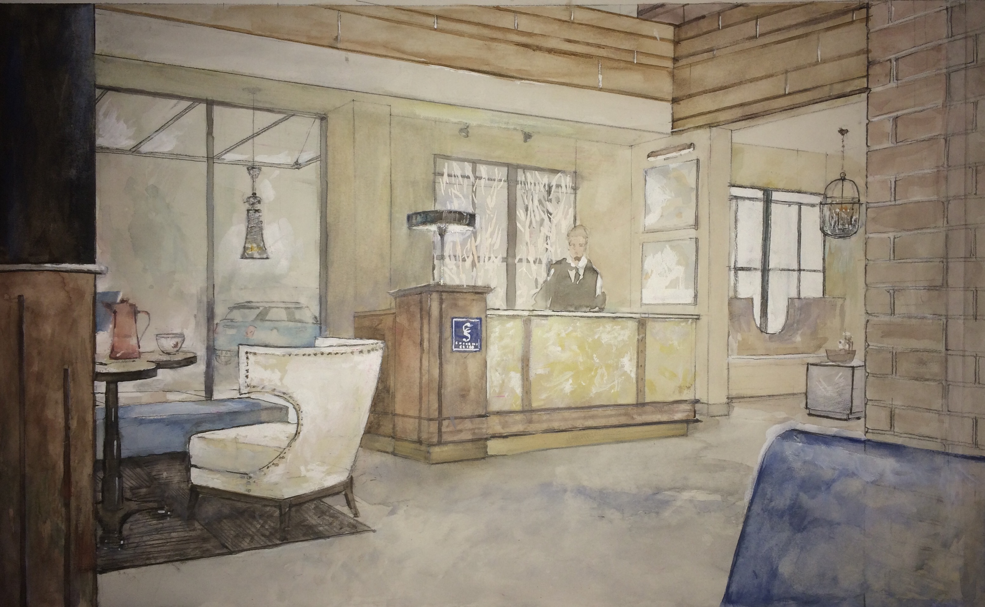
Design Plan
      Hand Drawn Perspectives

Slide 15
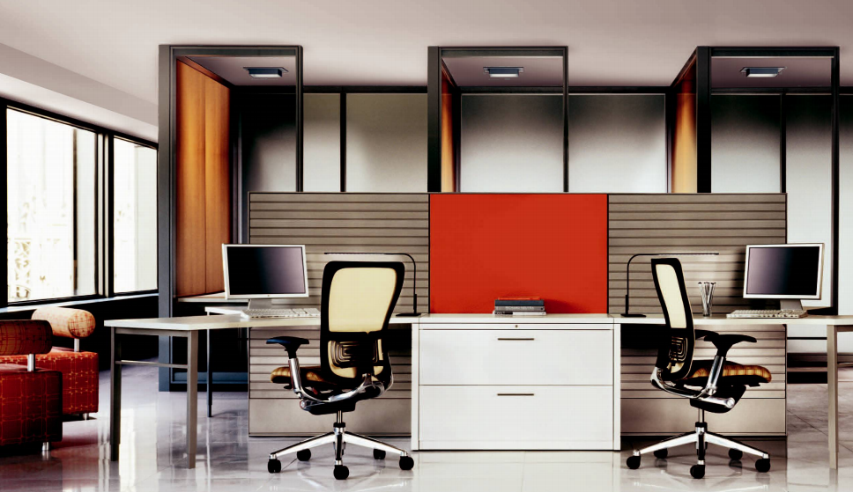


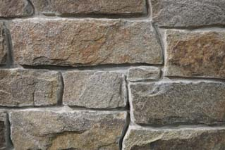
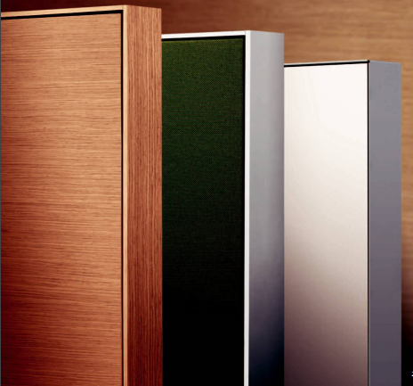
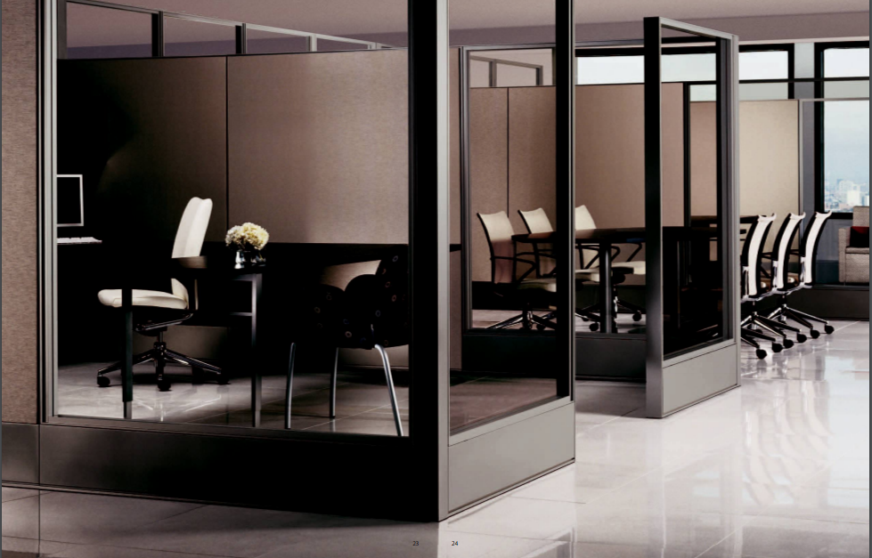

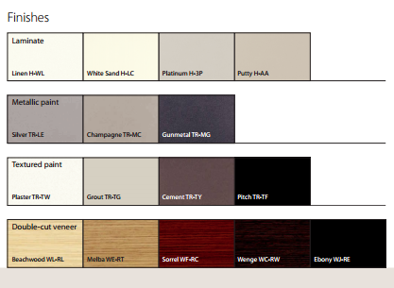
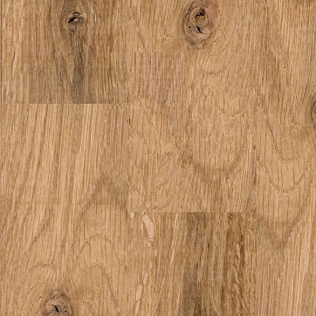
Design Plan
      Job Specifications – Office Space

Slide 16
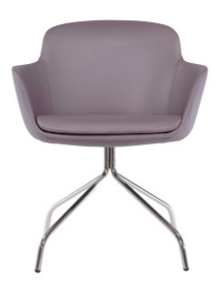
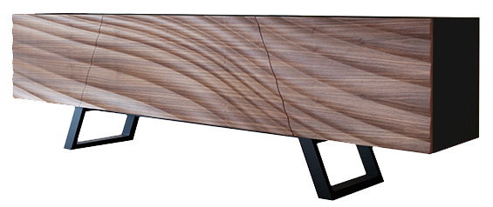
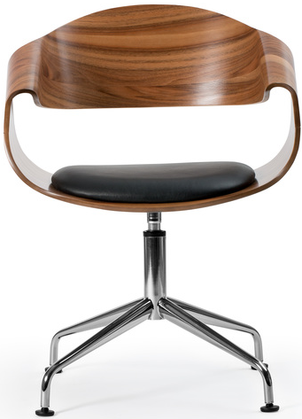
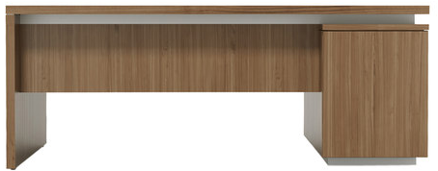
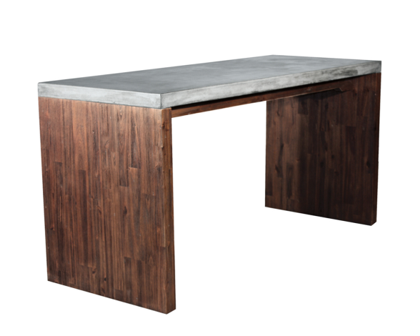
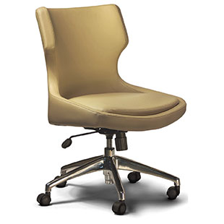
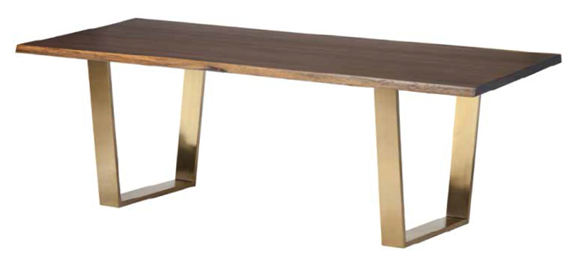
Design Plan
Office Furnishings:
      Job Specifications: Amenity Spaces & Leasing Offices
Conference Room:

Slide 17
View our Portfolio
  www.gacekdesign.com
  Recent Projects to Visit
    Ria Mar Restaurant & Bar, 25 Whitehead Ave, South River, NJ
    Judd Builder’s The Reserve at Creekside, Flourtown, PA
    K. Hovnanian’s Four Seasons at Monroe, Monroe, NJ
    K. Hovnanian’s Doylestown Greene, Doylestown PA
    County Builder’s Walden Square, Newtown PA
    The Legacy at Mountain Lakes, Mountain Lakes, NJ
    Mignatti Homes’ Waterside, Bensalem, PA

Slide 18
Thank you!
gacekdesign.com

